Slide 1

AI Agent for Playing the Game of Ultimate Tic Tac Toe
Names: Vraj Patel, Daishak Patel
University of South Florida
CAP4621 – Introduction to AI
April 9, 2024

Slide 2
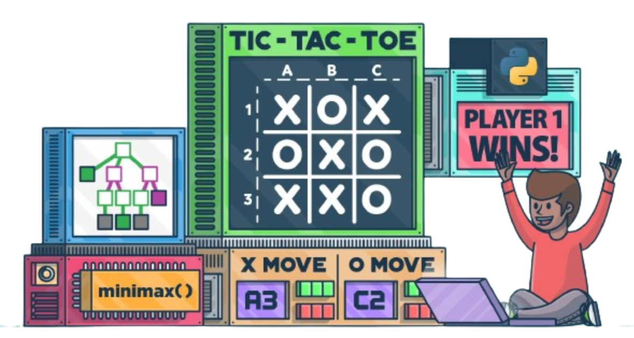
Overview of Ultimate Tic Tac Toe
Objective: Creating an AI agent using adversarial search techniques
Techniques Used: Minimax, Alpha-Beta Pruning
Evaluation: Heuristic Evaluation Functions

Slide 3
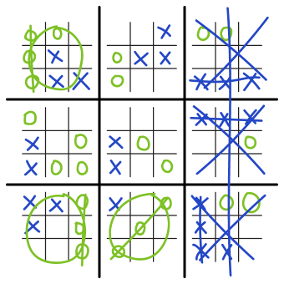
Introduction
Introduction to Ultimate Tic Tac Toe
Ultimate Tic Tac Toe is a strategic variation of the classic game Tic Tac Toe.
It features a multi-grid structure, comprising nine smaller Tic Tac Toe grids arranged in a 3x3 layout within a larger 3x3 grid.

Slide 4
Introduction (Continued)
Description of the game setup and gameplay
Each small grid functions like standard Tic Tac Toe.
Victory entails dominating the larger 3x3 grid.
Players take turns placing marks in the large grid.
Placement dictates the next small grid for the opponent.
Capturing a small grid marks the corresponding large grid cell.
Occupied or won small grids grant "free go" opportunities.
Game ends with a player winning three small grids or full capacity of the large grid.

Slide 5
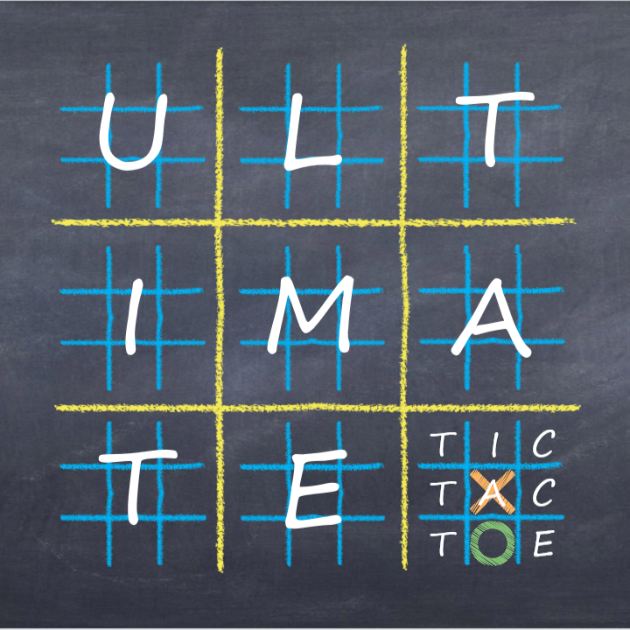
Game Setup
3x3 grid comprising nine smaller grids
Victory conditions: Three small grids in a row
Victory is achieved by securing three small grids in a row, either horizontally, vertically, or diagonally, within the larger 3x3 grid.

Slide 6
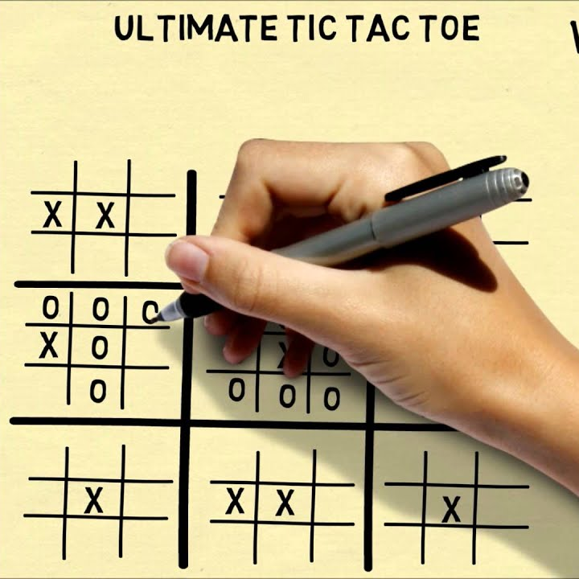
Game Play
Players alternate placing marks
Each player takes turns placing their respective marks (X or O) on the grid.
Turns switch between players after each move is made.
Choice of square dictates opponent's next move
The square in which a player places their mark determines the next small grid where their opponent must play.
This strategic choice influences the flow of the game and can impact the opponent's options.

Slide 7
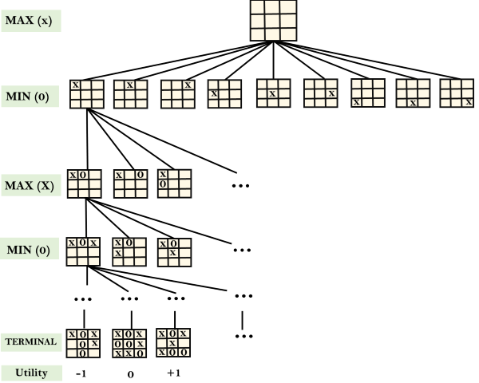
Objective of the AI System
Developing an AI system for Ultimate Tic Tac Toe
Create an opponent capable of engaging human players.
Enhance gameplay experience through strategic decision-making.
Leveraging adversarial search algorithms
Utilize adversarial search algorithms like minimax.
Integrate optimization techniques such as alpha-beta pruning.
Incorporate heuristic evaluation functions for efficient move selection.

Slide 8

Description of AI System
Foundation in the minimax algorithm
Utilize minimax algorithm for decision-making
Minimax recursively explores game states
It maximizes AI's chances while minimizing opponents'
Integration of alpha-beta pruning
Reduces nodes evaluated in the search tree.
Eliminates worse branches, speeding up computation.
Enables deeper exploration within limited resources.

Slide 9
AI Agents Implemented and Tested
Random Agent (R) – randomly selects from legal moves
Minimax Agent (M) – this agent used raw minimax, depth limit of 3
Alpha Beta Pruning Agent (AB) – augmented minimax with alpha beta pruning
Captured Regions Heuristic Agent (CR) – First agent with a heuristic: Number of captured regions.
Positional Advantage Heuristic Agent (PA) - Count of the number of opportunities a player has.
Free Goes Heuristic Agent (FG) - Number of free goes offered to the opponent

Slide 10
Experimental Results
AI Agent | R | M | AB | CR | PA | FG
Wins out of 50 | 2 | 5 | 7 | 14 | 41 | 34
Win Ratio | 4% | 10% | 14% | 28% | 82% | 68%
Average Response Time (s) | 0.8 s | 6.7 s | 3.3 s | 3.6 s | 4.5 s | 5.1 s
Average number of nodes searched | 156 | 504,632 | 204,126 | 190,045 | 210,121 | 196,447

Slide 11
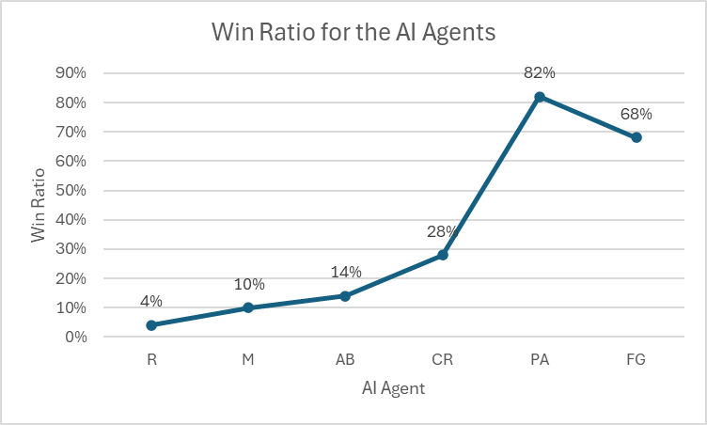
Main Conclusions
Optimal performance achieved with position heuristic
Position heuristic yields highest win rates.
Position-based evaluation proves most effective.
Demonstrates superiority of position heuristic in AI gameplay.
Evaluation of heuristic evaluation function
Comparison of different heuristic evaluation methods.
Assessing performance based on win rates and efficiency.

Slide 12
Discussion of Surprising Discoveries
Superior performance of position heuristic
Position heuristic excels in AI decision-making.
Outperforms other heuristics in win rates.
Provides strategic advantage by blocking opponent
Free Goes Heuristic Did Not Help
Win rate decreased after including the free goes heuristic
Could be due to fact that minimax algorithm already accounts for this concept.

Slide 13
Challenges Encountered
Absence of established heuristic functions
Development challenges and iterative refinement

Slide 14
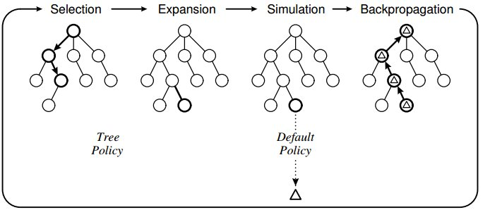
Future Work
Exploration of Monte Carlo Tree Search
Investigate Monte Carlo Tree Search (MCTS) for future AI development.
Seeks to leverage MCTS for improved performance in complex environments.
Refinement of heuristic functions
Enhance existing heuristic functions to improve AI performance.
Strive to develop more accurate and efficient heuristic evaluation criteria.

Slide 15
References
[1] “Ultimate tic-tac-toe,” The Game Gal, Sep. 2018.https://www.thegamegal.com/2018/09/01/ultimate-tic-tac-toe/ (accessed Apr. 7, 2024).
[2] in, “The Minimax Algorithm 101,” Japlslounge.com, 2020.https://japlslounge.com/posts/articles/Minimax_Blog/1.htm (accessed Apr. 14, 2024).
[3] Gila, O., “Ultimate tic-tac-toe,” Wikipedia, Oct. 18, 2023. https://en.wikipedia.org/wiki/Ultimate_tic-tac-toe (accessed Apr. 10, 2024).

Slide 16

Thank you

